Slide 1
Topics
* Newton’s Laws
* Application of Newton’s Law

Slide 2


Newton’s Law:
Newton’s First Law
“If no net force acts on a body (Fnet = 0) , the body’s velocity cannot change; that is, the body cannot accelerate.
Newton’s 2nd Law
“When viewed from an inertial reference frame, the acceleration of an object is directly proportional to the net force acting on it and inversely proportional to its mass”
“The net force on a body is equal to the product of the body’s mass and its acceleration”.

Slide 3
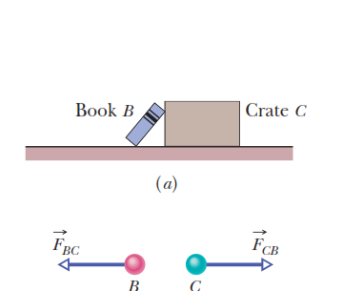
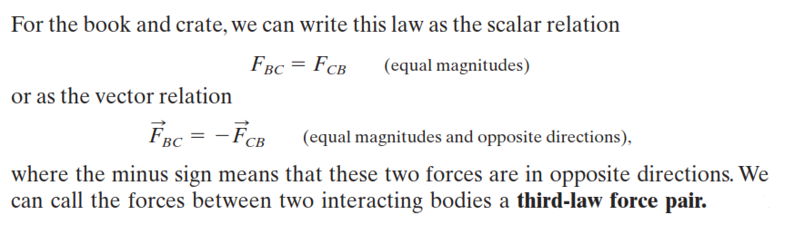
Newton’s 3rd Law
“When two bodies interact, the forces on the bodies from each other are always equal in magnitude and opposite in direction.”

Slide 4
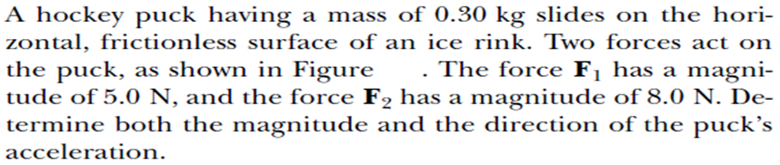
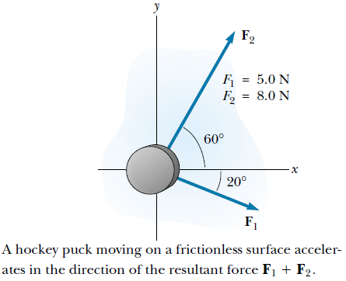
Applications of Newton's Laws
a = 34 m/s**2
Angle= 30.98 degree.

Slide 5
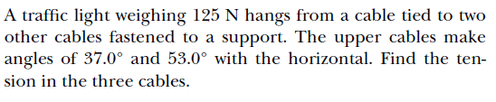
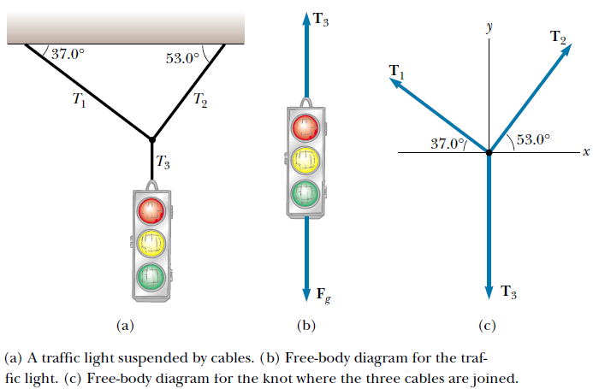

Slide 6
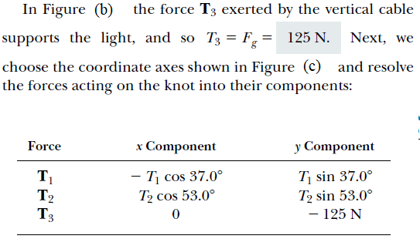
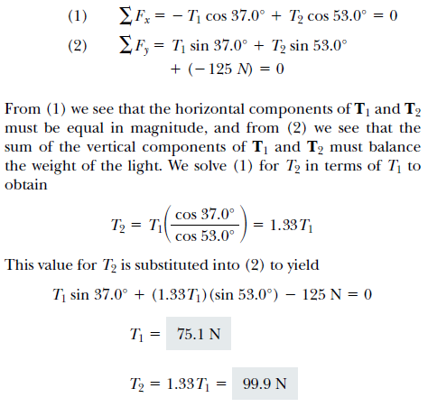

Slide 7
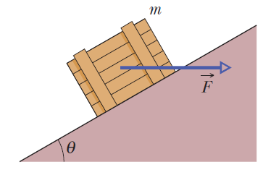
A crate of mass 100 kg is pushed at constant speed up a frictionless ramp at 30 degree by a horizontal force. What are the magnitudes of (a) Force (b) the force on the crate from the ramp?

Slide 8
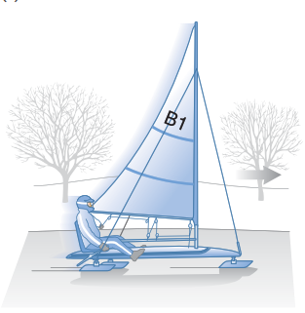
An iceboat is at rest on a frictionless horizontal surface. A wind is blowing along the direction of the runners so that 4.0 s after the iceboat is released, it is moving at (about 6.0 m/s ). What constant horizontal force does the wind exert on the iceboat? The combined mass of iceboat and rider is 200 kg.

Slide 9
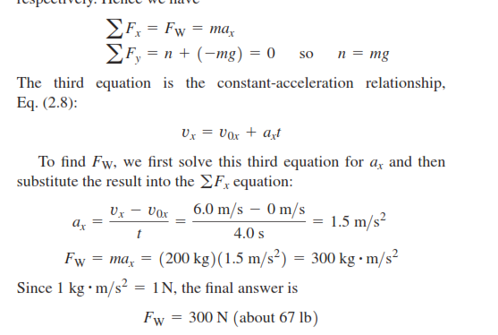
Answer

Slide 10


Friction
The kind of friction that acts when a body slides over a surface is called a kinetic friction force.
In static friction, the frictional force resists force that is applied to an object, and the object remains at rest until the force of static friction is overcome.

Slide 11
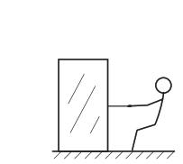
You want to move a 500-N crate across a level ﬂoor. To start the crate moving, you have to pull with a 230-N horizontal force. Once the crate “breaks loose” and starts to move, you can keep it moving at constant velocity with only 200 N. What are the coefﬁcients of static and kinetic friction?

Slide 12
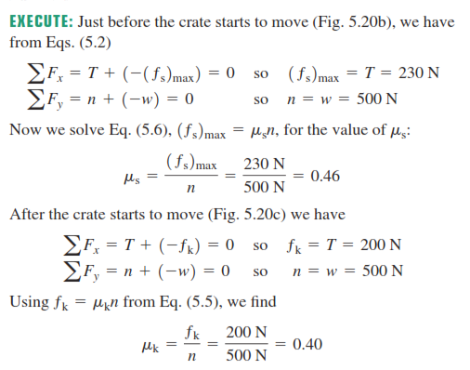
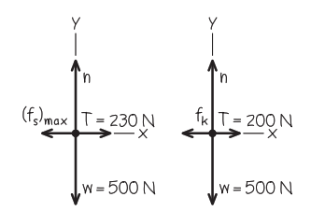
Answer

Slide 13
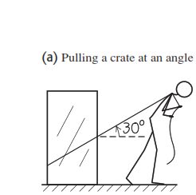

suppose you move the crate (W=500N) by pulling upward on the rope at an angle of above the horizontal. How hard must you pull to keep it moving with constant velocity? Assume that $μ_{k}$= 0.40.

Slide 14
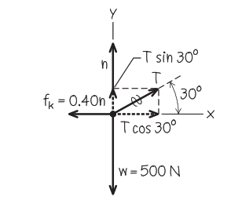
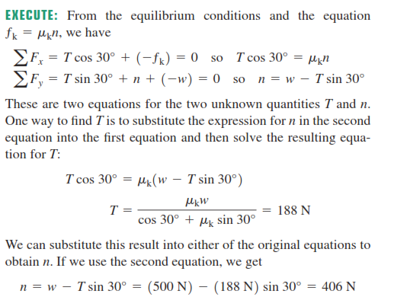
answer

